Slide 1

Date: | Human Biology Year 12 ATAR
Do Now Get out your equipment and textbook. Lesson Agenda 1: Do Now 2: Review of DNA Alleles and Genes 3: Start on the Review Worksheet 4: Lesson summary and wind-up Suggested Study Complete review worksheet, then mark and correct using the answer key on Connect (compulsory). NEXT LESSON Past Exam Question Meiosis and sources of human variation | Learning Aims Review understandings of DNA, Alleles and Genes including: Structure of DNA Replication of DNA Genes, protein production and protein functions Structure of proteins Structure of chromosomes Alleles Human karyotype
 | Key Vocabulary DNA Replication Gene Base sequence mRNA tRNA Protein Allele

Slide 2
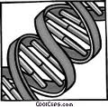
DNA: Structure and Replication
Revision prior to Ch 9 HP

Slide 3
DNA
DNA: DeoxyriboNucleic Acid
Found in nucleus of cells of all living things
Contain genetic information
Recipe for making proteins used by body and for cell division, replication and repair; and managing chemical reactions (enzymes)
Complex molecule arranged in very long strands
Human cells have 46 DNA molecules (23 pairs)
Each molecule = 1 chromosome.
Learning Aim: Review Structure of DNA

Slide 4
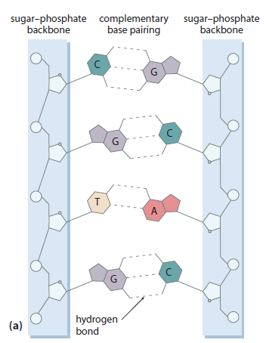
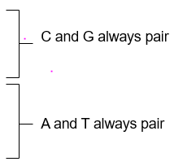
Structure of DNA molecule
Very LONG strands
Like a ladder:
Sugar phosphate sides
Rungs of base pairs
Base pairs:
Joined by hydrogen bonds
C = Cytosine
G = Guanine
T = Thymine
A = Adenine
Strands twisted into helix
Learning Aim: Review Structure of DNA

Slide 5
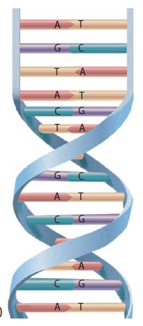
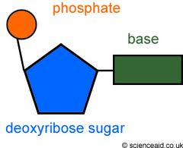
Strands are twisted into a “double helix”
Nucleotide = Phosphate, sugar and base
Learning Aim: Review Structure of DNA

Slide 6
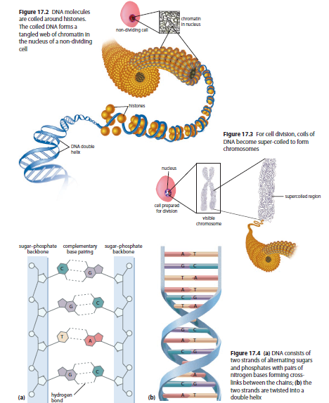
In a non-dividing cell:
Double helix wound around histones.
Forms coil structure.
Forms tangled web of chromatin in nucleus
During cell division
Coils of DNA become super-coiled
Forms chromosome structure
Learning Aim: Review Structure of DNA

Slide 7
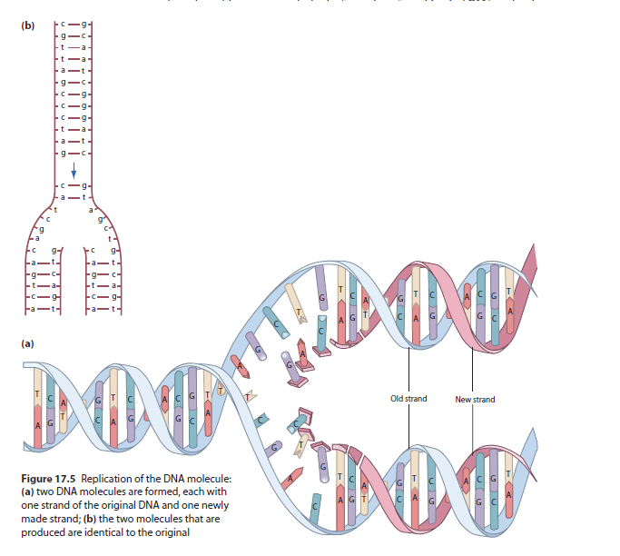
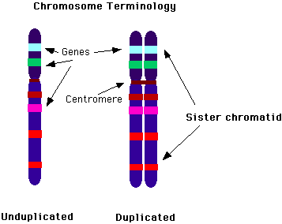
DNA Replication
Replication = copying = duplication
During interphase, chromatids replicate ready for division:
Chains with base pairs separate, and new base pairs join to each half.
Learning Aim: Review Replication of DNA

Slide 8

DNA makes Proteins
Revision prior to Ch 9 HP

Slide 9
Genes in DNA code for protein production
Genes are long sequences of DNA base triplets that code for amino acids to be assembled (see picture) into long strands.
These strands fold, and bind, and form specifically structured proteins.
Each human gene codes for between 1 and 3 proteins.
Proteins perform a variety of functions:
Structural material for cells
Control of chemical reactions (enzymes are proteins)
Control of some aspects of membrane transport (as protein channels and/or receptors)
Genes can be switched on or off depending on the cell’s purpose (remember cell differentiation?)
Learning Aim: Review Genes, Protein Synthesis and functions of proteins

Slide 10
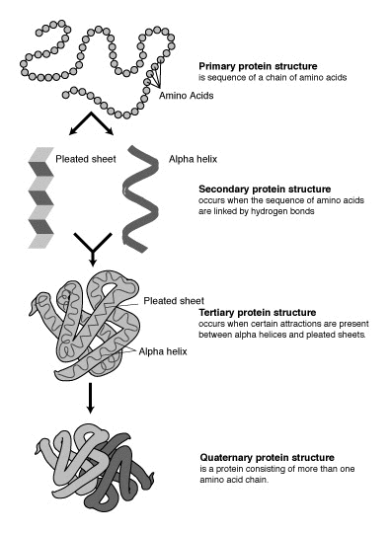
Genes in DNA code for protein production
Proteins are complex structures made from chains of amino acids.
Lots of different proteins:
Different shapes, sizes and functions
Made from different combinations of amino acids
Assembled by interaction of:
Ribosomes
tRNA which carries amino acids and a corresponding triplet codon
mRNA carrying instructions
Learning Aim: Review Structure of Proteins

Slide 11
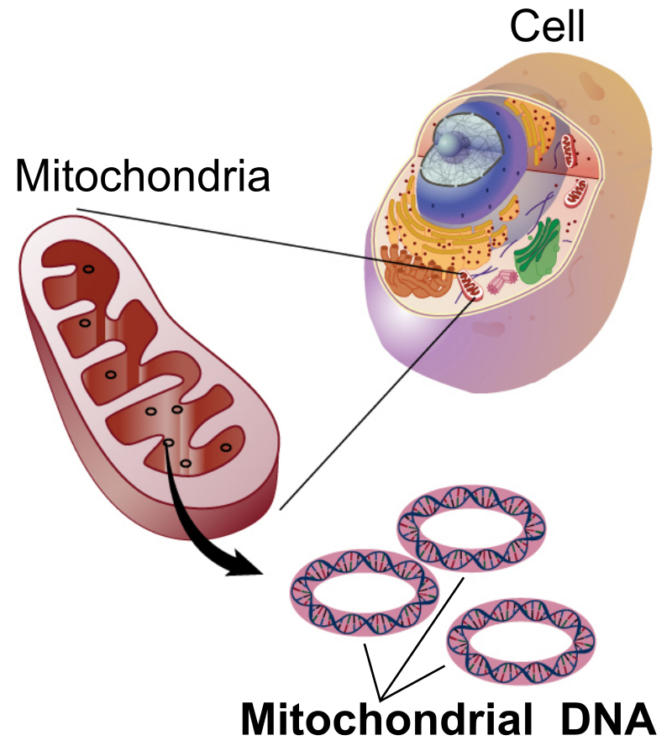
Mitochondrial DNA
Mitochondria have their own DNA!
Small circular molecules rather than large strands
Codes for enzymes used in cellular respiration
Inherited entirely through the mother –why?
Can trace populations through mitochondrial DNA

Slide 12
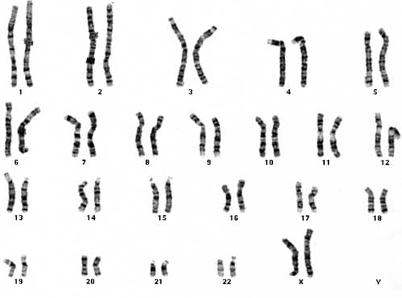
DNA and Karyotypes
Revision prior to Ch 9 HP

Slide 13

This is Fred.
Learning Aim: Review structure of chromosomes, gene location and alleles

Slide 14
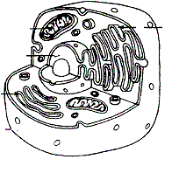
This is one of many cells that make up Fred’s body.
In the nucleus, Fred’s cell has DNA, which codes for Fred’s characteristics.
Learning Aim: Review structure of chromosomes, gene location and alleles

Slide 15
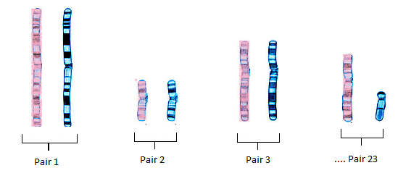
During Interphase (resting phase), Fred’s DNA is arranged in 46 very long strands in the nucleus.
The 46 strands are organised into 23 pairs.
Each pair contains the same genes. There are around 30 000 genes in the human genome (the total number of genes in the 23 chromosome pairs)
Learning Aim: Review structure of chromosomes, gene location and alleles

Slide 16
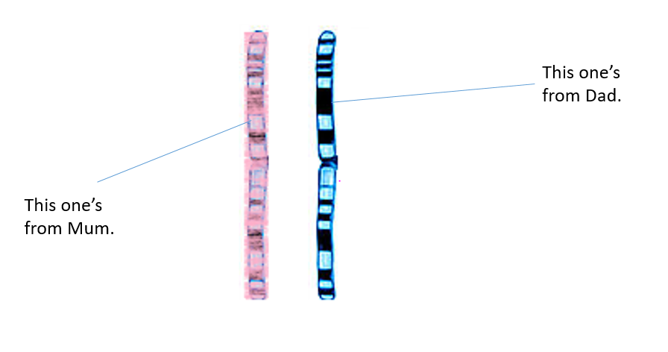
Fred has inherited one half of each pair from his Mum, and one from his Dad.
This one’s from Dad.
This one’s from Mum.
Learning Aim: Review structure of chromosomes, gene location and alleles

Slide 17

Each half of the pair contains genes for the same things, but Fred has inherited different variants (alleles) from each parent:
Dimple gene: inherited dominant “dimpling” version from Dad. [D]
Dimple gene: inherited weaker “non-dimpling” version from Mum. [d]
Fred has dimples because the dominant variant (allele) of the gene he got from his dad “overcame” the weaker variant from his Mum. The “dimpling” gene is really a code giving instructions for protein production to the muscles in the cheek, which affects how those cells arrange themselves. One variant of the protein production results in dimples. The other does not. In this case the dimpling gene is dominant.
Learning Aim: Review structure of chromosomes, gene location and alleles

Slide 18
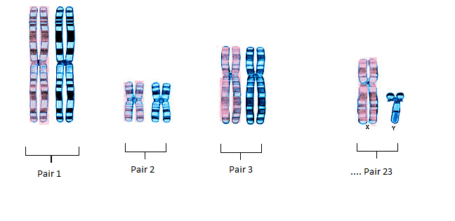
When Fred’s cell is ready to divide, each of the chromosomes replicates, or copies itself exactly. So now the pairs look like this:
Learning Aim: Review structure of chromosomes, gene location and alleles

Slide 19
When we are discussing DNA and gene inheritance, it is less confusing if we look at the chromosomes during Interphase, like this:
Learning Aim: Review structure of chromosomes, gene location and alleles

Slide 20
Some traits (eg Fred’s dimples) are the result of one gene. Others are the result of several genes on several chromosomes (eg Fred’s hair colour)
Some genes have a greater effect on the body than others. A gene controlling whether or not dimples develop doesn’t have a huge effect, but inheriting two non-working alleles of the gene that regulates mucus breakdown in the lungs has a big effect: Cystic Fibrosis.
Another example: inheriting an allele that has mutated to damage tissue can also cause huge problems – eg: Huntington’s Disease
Learning Aim: Review effects of genes and alleles

Slide 21
A karyotype is a picture of all the chromosomes in a cell.
Sometimes human karyotypes are shown as the chromosomes would appear in interphase:
Learning Aim: Review karyotypes

Slide 22
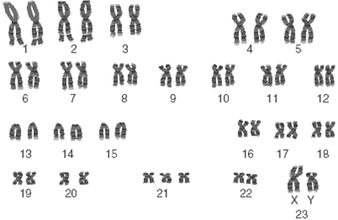
Other times human karyotypes are shown as the chromosomes would appear just before cell division, when the chromosomes have replicated:
Learning Aim: Review karyotypes

